Slide 1

Phase-2 WiFi Password Breaker & Enhancing Network Security
Presented by:
Arshman Anees,
Abdul Hadi and Tayyab Tahir

Slide 2

Introduction & Objectives
Objective
Objective
Identify WiFi vulnerabilities using ethical hacking.
Educate users on improving network security.
Scope of Phase 2
System design, technical architecture, and implementation plan.

Slide 3
System Overview
Type
Key Components
Modes of Operation
Hardware-based penetration testing system using Raspberry Pi.
Raspberry Pi, WiFi adapter (monitor mode support). Kali Linux, Aircrack-ng, Hashcat, Wireshark.
Standalone testing & remote access via SSH.

Slide 4
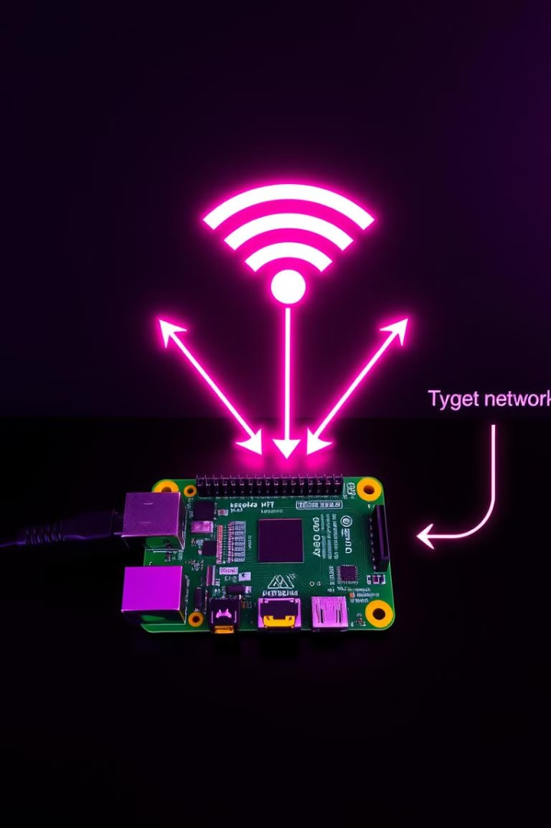
Technical Architecture
1
1
Capturing WiFi packets.
2
2
Analyzing encryption and vulnerabilities.
3
3
Cracking passwords ethically and reporting findings.

Slide 5

Use Cases & User Interactions
Primary Users
Secondary Users
Ethical hackers, IT professionals.
Educators, students.
Core Use Cases
Performing penetration tests. Conducting security audits. Generating security improvement reports.

Slide 6




Component Interactions & Workflow
1
Packet sniffing via monitor mode.
2
Applying attack techniques (dictionary, brute-force, etc.).
3
Analyzing cracked passwords and generating reports.

Slide 7
Technology & Deployment
Software Stack
Hardware Requirements
Connectivity
Kali Linux, airodump-ng,
aircrack-ng
Raspberry Pi , external WiFi adapter.
SSH access for remote operations. LAN/WAN deployment for extended functionality.

Slide 8



Updated Project Plan
Completed
1
Research, Planning, Requirements, Design.
In Progress
2
Development of Modules.
Next
3
Testing & Report Finalization.

Slide 9


Considerations
Ethical Considerations
Responsible use of penetration testing tools. Ensuring compliance with cybersecurity laws.

Slide 10
Conclusion & Next Steps
Upcoming Tasks
1
Completing development & testing. Preparing final report & demo.
Final Remarks
2
Emphasizing responsible ethical hacking for cybersecurity improvement. Q&A Session.

